Slide 1
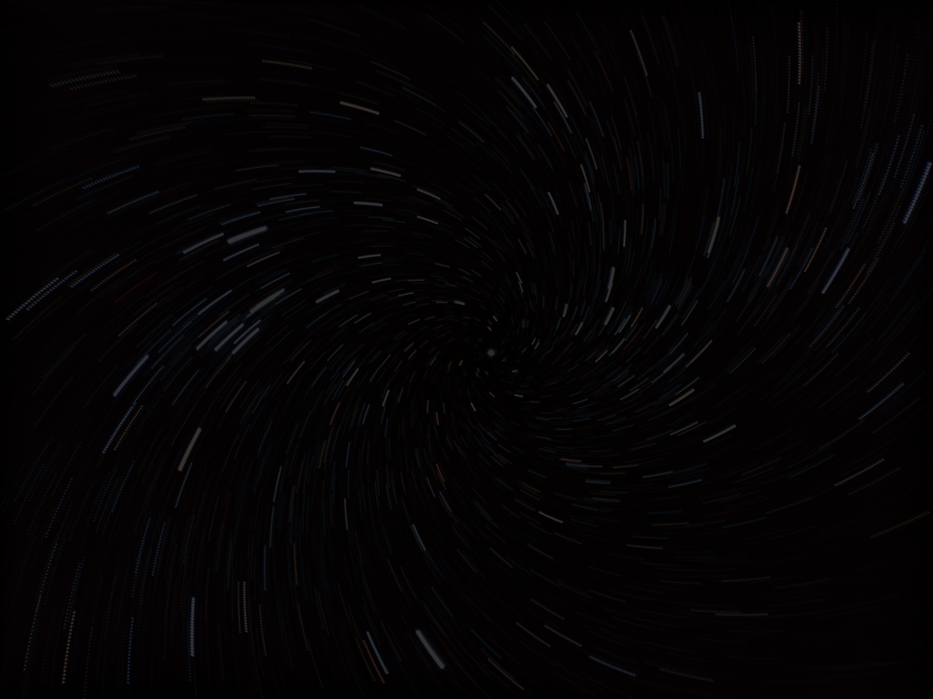
A Study in Procedurally Generated MiniGrid Environments
TTIFFANY & SHARMIL

Slide 2
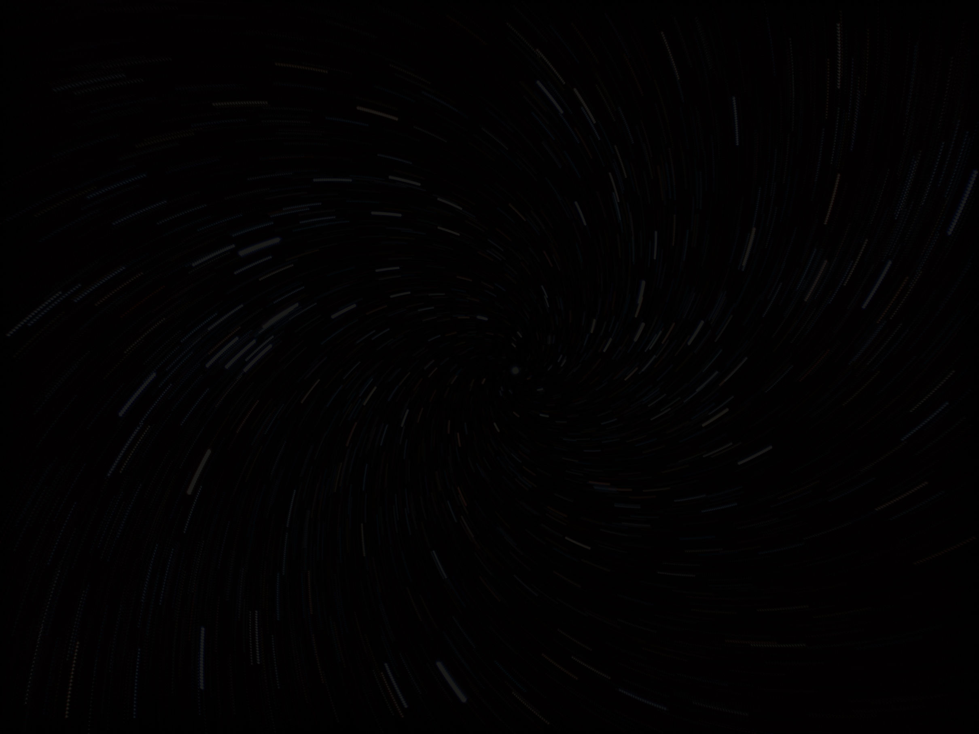

Why Study Generalization in RL?
RL agents often perform well in training but fail in new environments.
Real-world systems (robotics, navigation, autonomy) require robustness.
Procedural generation allows testing generalization under distribution shift.
Key Question: Can PPO generalize to unseen layouts?

Slide 3
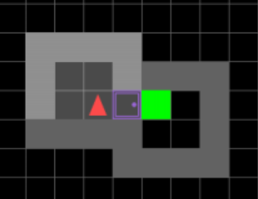
Environment: MiniGrid MultiRoom
Discrete grid world
Agent must navigate rooms and doors to reach a goal
Sparse reward: +1 only at goal
Procedurally generated via random seed
Each seed = new layout

Slide 4

Algorithm: Proximal Policy Optimization (PPO)
Policy-gradient method
Learns stochastic policy π(a|s)
Uses clipped objective for stable updates
Optimizes expected cumulative reward

Slide 5


Attempt 1: Limited Training Distribution
Train seeds: 0–19 (20 layouts)
Test seeds: 20–39 (unseen layouts)
200k timesteps
Default PPO (ent_coef = 0.0)
Attempt 1
Attempt 1 Results
Mean reward on test seeds (20-39): 0.0000
Min: 0.0000, Max: 0.0000
The agent got no reward., so it never reached the goal on any of those levels.

Slide 6

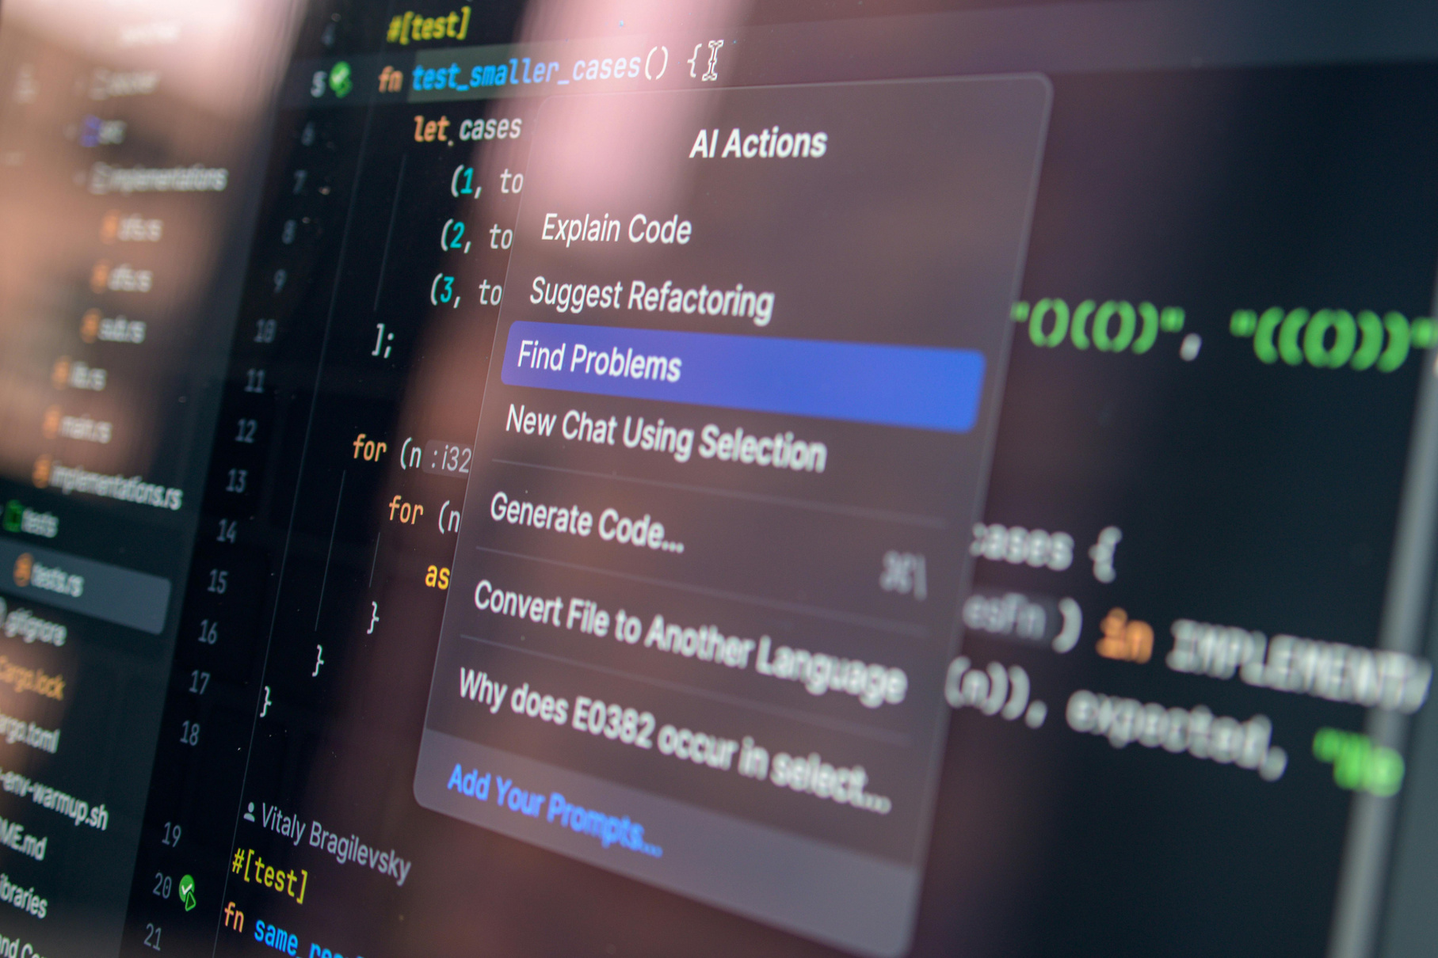
Problems
Identified Failure Mode
Why It happened
Narrow training distribution (20 seeds)
Sparse rewards
No entropy regularization
Deterministic collapse of policy
Limited exploration
Severe overfitting to training layouts.
Memorized spatial patterns.
Learned brittle navigation strategy.
Cannot handle distribution shift.

Slide 7
Mitigation Strategy
Increased training seeds (0–99)
RandomSeedWrapper (new layout every episode)
Entropy bonus (ent_coef = 0.01)
Increased training steps (500k)
Tuned PPO hyperparameters
Mitigation Strategy (Attempt 2)
Attempt 2 Results
Train mean reward: ~0.83
Test mean reward: ~0.85
Min: 0.7750, Max: 0.9100

Slide 8

Why These Fixes Work
More seeds → broader state distribution
Randomization → prevents memorization
Entropy → sustained exploration
Longer training → stable value estimation

Slide 9

Key Insight
Reward structure unchanged.
Sparse reward remained.
Improvements came from distribution diversity.
Entropy improved exploration.

Slide 10

Broader Implications
RL agents easily overfit.
Distribution shift is a major vulnerability.
Procedural training improves robustness.
Exploration regularization is critical.

Slide 11

Conclusions
Identified failure: poor generalization.
Demonstrated catastrophic test collapse.
Mitigated via distribution expansion + entropy.
Achieved robust performance on unseen layouts.
Robust RL requires training diversity, not just longer training.

Slide 12

Future Work
Reward shaping
Domain randomization
Larger environments (N6, N8)
Evaluate under adversarial perturbations

Slide 13
Thank You

